Slide 1

Welcome

Slide 2
into

Slide 3
the

Slide 4
mind

Slide 5
Of a
designer

Slide 6
I

Slide 7
want

Slide 8
to

Slide 9
leave

Slide 10
you

Slide 11
Impressed.

Slide 12
Impressed.

Slide 13
Buckle up

Slide 14
Always

Slide 15
Aim

Slide 16
high

Slide 17
Make

Slide 18
The

Slide 19
possible
im

Slide 20
ready

Slide 21
For every

Slide 22
Challenges.

Slide 23
Team worker

Slide 24
But

Slide 25
stop
talking
about

Slide 26
Me!

Slide 27
allow

Slide 28
me

Slide 29
demonstrate

Slide 30
my creativity

Slide 31
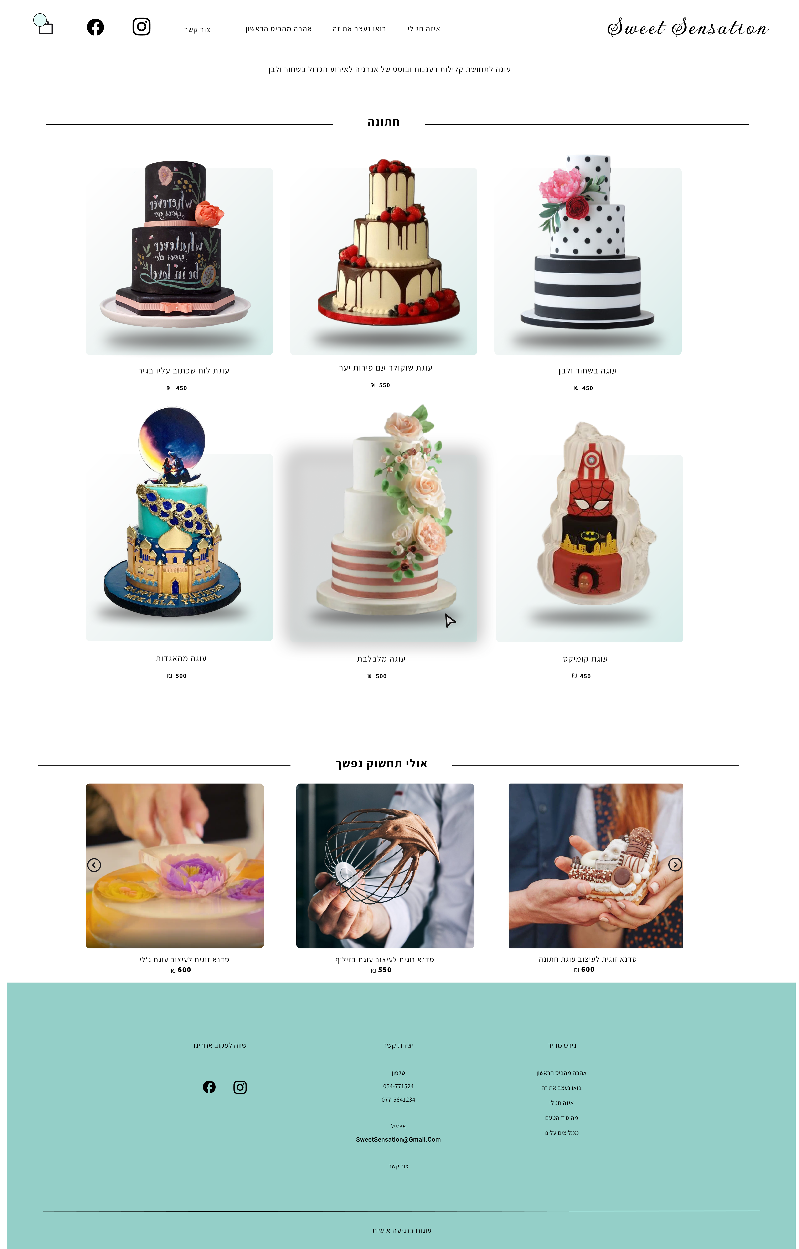
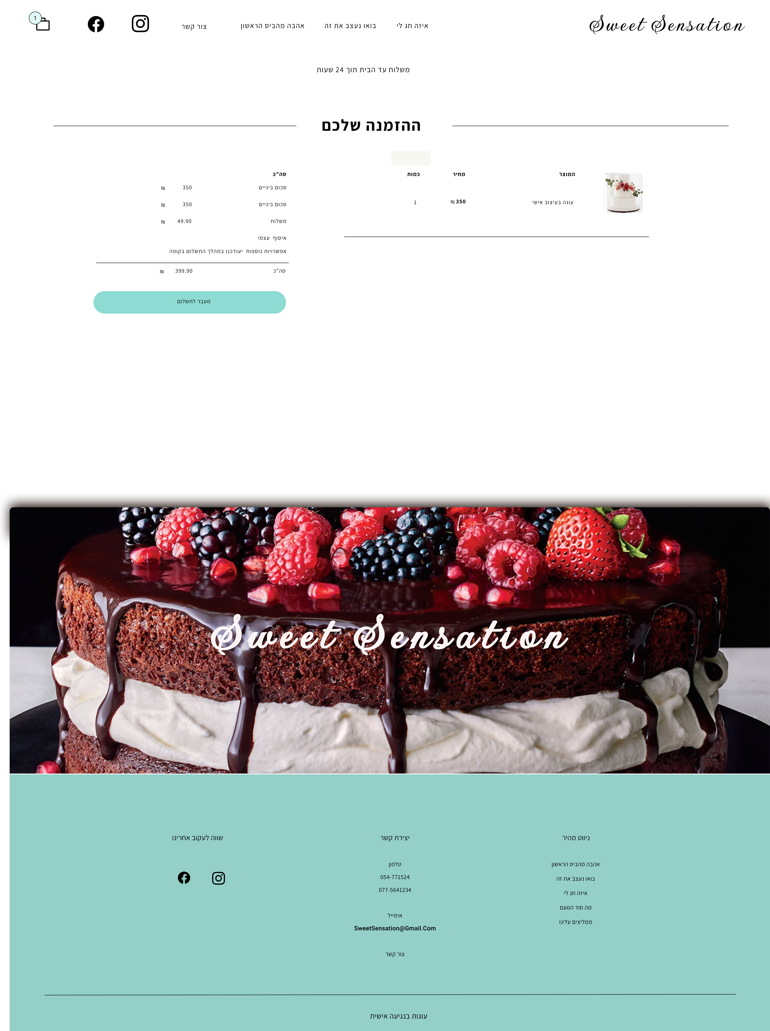
Web design

Slide 32
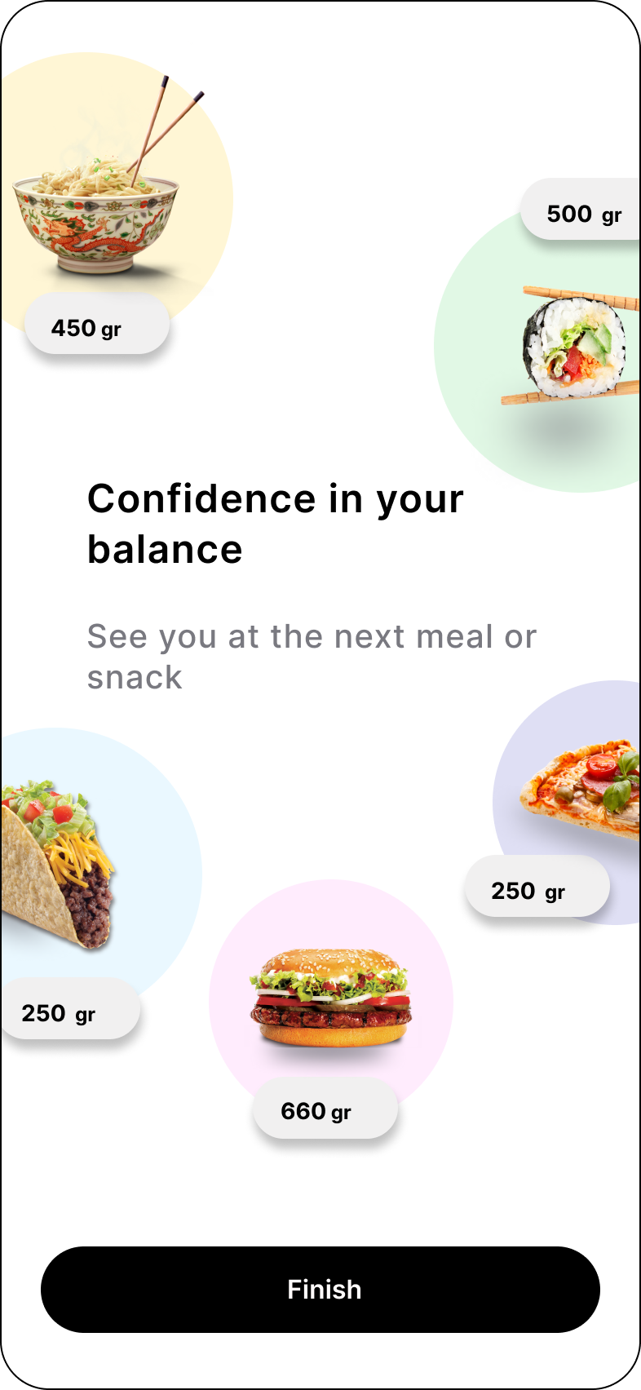
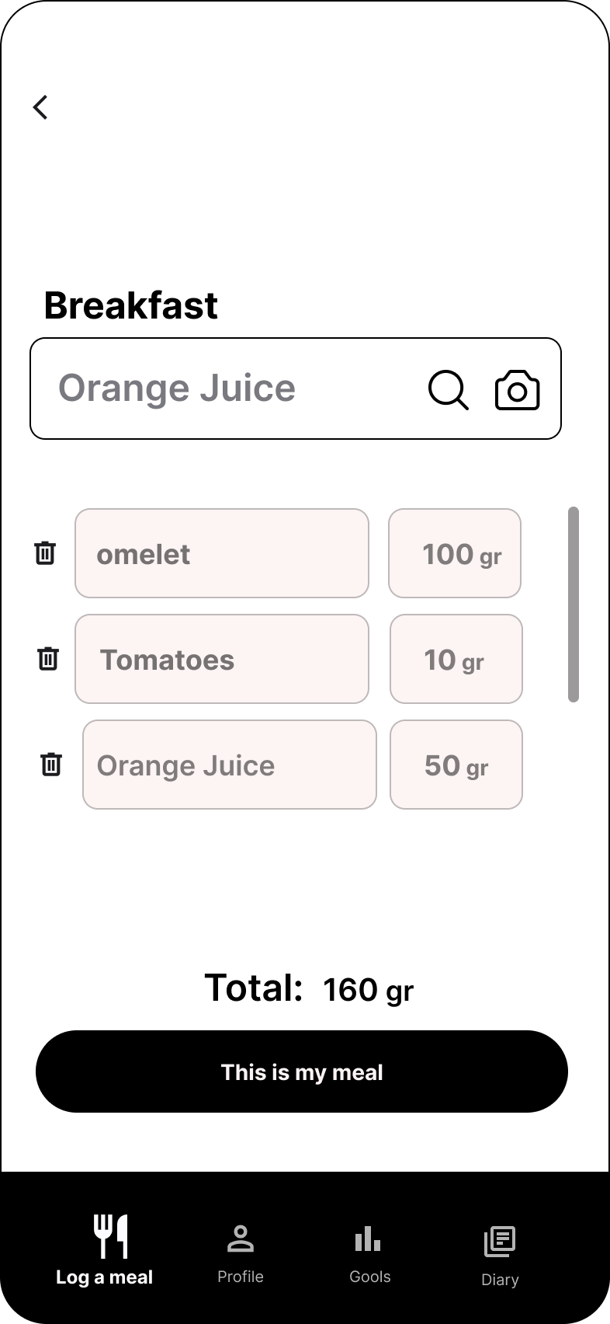
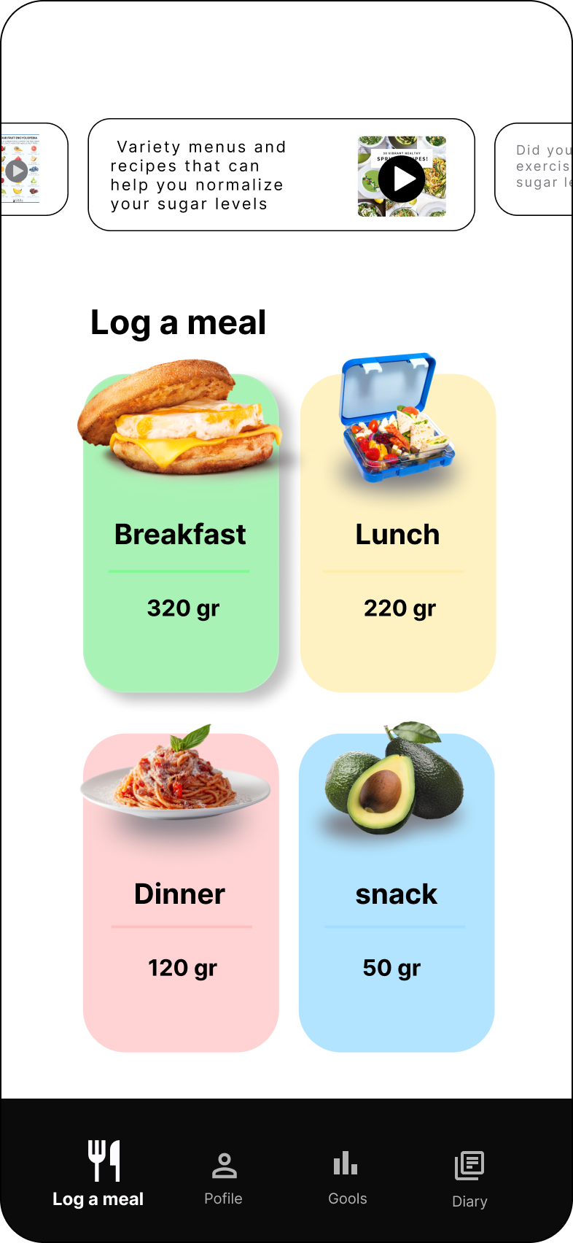
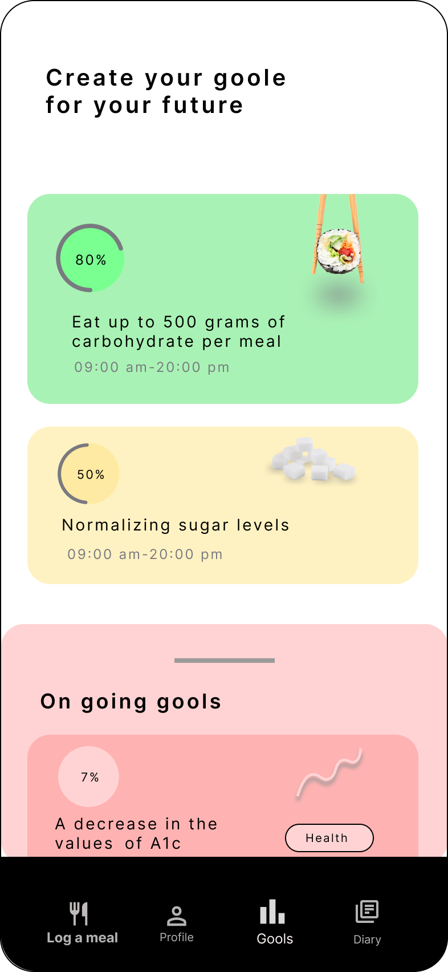
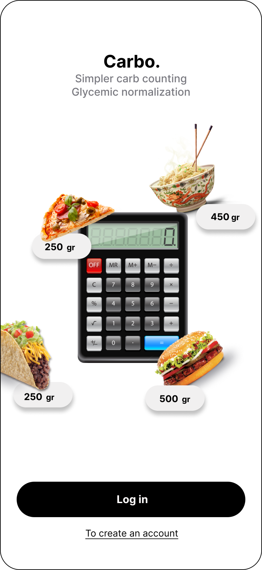
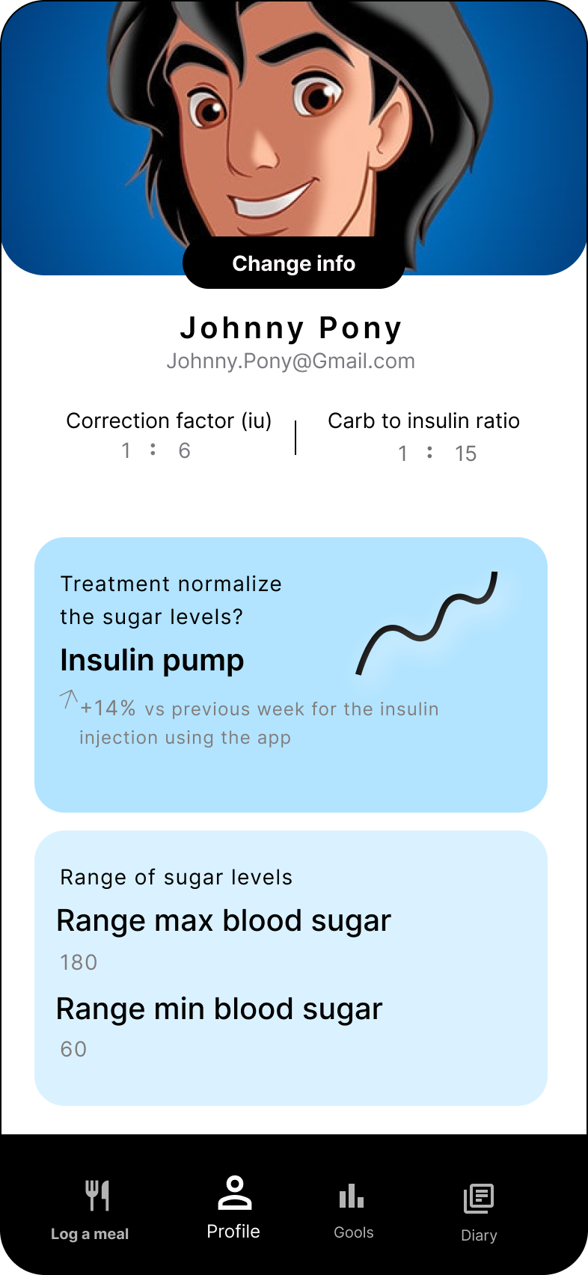
App design

Slide 33
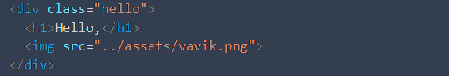
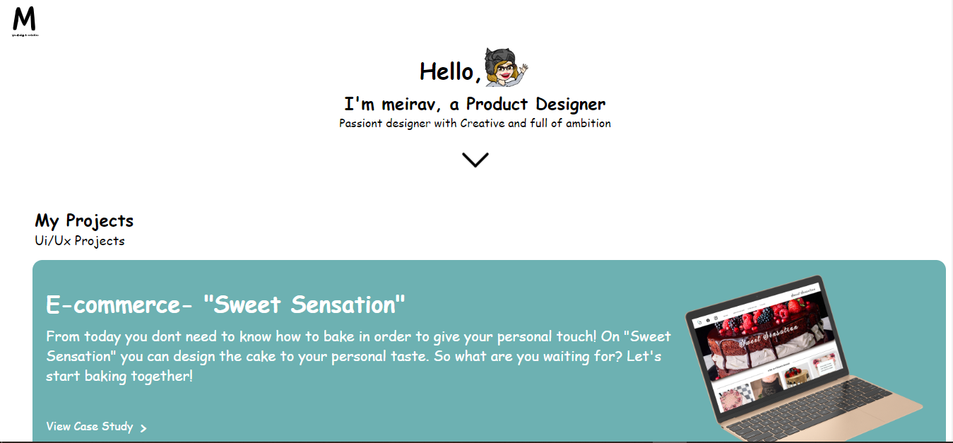
<h1>Website Construction</h1>

Slide 34
with

Slide 35
the

Slide 36
help

Slide 37
of
software
such
as

Slide 38






Slide 39
Keep in touch
Thank you !

